Slide 1
Spidermon

Slide 2
Abstract
Why
Cellular network operators deploy base stations with a high density to ensure radio signal coverage for 4G/5G networks
An adversary could detect human movements and recognize keystroke movements of a victim by passively listening to the CRS broadcast from base stations
How
SpiderMon, passive continuous keystroke monitoring using the signal transmitted by commercial cellular base stations

Slide 3
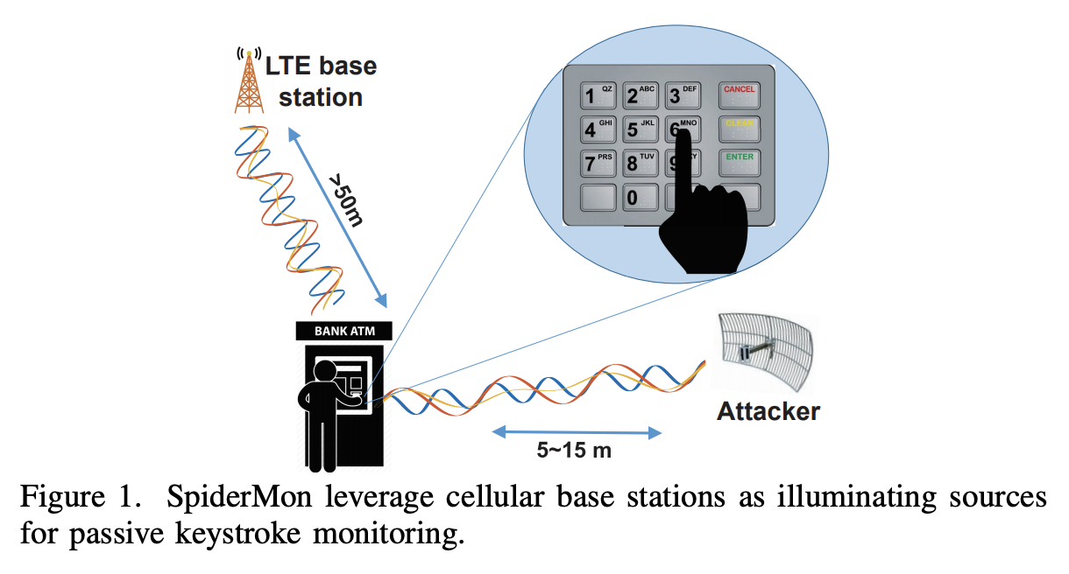
Introduction
Researchers have discovered that Wi-Fi radio signals can also be used as the medium for keystroke inference attacks
Most of these existing attack models are short-ranged or requires active signal transmission
This research shows that an attacker can passively listen to the commercial 4G/5G signals and infer the keystroke sequence of a victim at a distance of 15 meters

Slide 4
Introduction
The cellular signal is a new type of side-channel attack medium that could be more harmful than Wi-Fi signals
Harder to detect these attackers since they do not transmit any signal; they use the base stations as the “illuminating source”
Cellular signals have larger coverage areas than Wi-Fi signals
Wi-Fi transmissions could be easily blocked since they use Carrier-Sense Multiple Access (CSMA) protocols. However, it is against FCC regulations to interfere with cellular transmissions. Thus, users cannot protect themselves by transmitting an interfering signal, as suggested in PhyCloak

Slide 5
Introduction
Challenges for SpiderMon
capturing the subtle changes caused by the keystroke movements at a distance of 15 meters is challenging
Use a directional antenna to amplify the signal reflected by the victim, as well as reducing the interferences of nearby movements. Design a block Principal Component Analysis (PCA) algorithm that further amplifies the signal by combining signals in different subcarriers
Infer the keystroke sequence of a continuous typing process, where the victim types in a natural manner by continuously moving from one key to the next
To handle continuous typing, model the process as a Hidden Markov Model (HMM) and use the LTE signal to infer the transition between subsequent keystrokes

Slide 6
Introduction
Challenges for SpiderMon
LTE signal contains both data transmission and reference signals so that the raw data rate is 122.88 MBytes per second, which makes real-time data processing and logging a challenge
To enable long-term monitoring, build a signal processing frontend running on a workstation that compresses the measurements to a rate of 800 kBytes per second so that the results can be efficiently processed and stored in real-time for hours

Slide 7
Related Work
LTE physical layer measurements
Radio Frequency (RF) based activity monitoring systems
Keystroke inference attacks
Protection against RF-based attacks

Slide 8
Attack scenario
The adversary attempts to infer the PIN code of a user when he/she inputs it on an ATM or a smart lock door
The adversary may not have direct access to the target, but can deploy equipment at a distance of 5∼15 meters, e.g., from a building across the road or behind a nearby wall
Assume that there is at least one LTE base station within a distance of 150 meters to the victim. The LTE coverage could be provided by a macro-cell or an indoor small cell
By passive listening to the LTE signal reflected by the victim, the adversary may infer the PIN input by the victim using a probability model

Slide 9
LTE Primer
Time Domain
LTE BSs transmit radio frames that have a fixed duration of 10ms. Each frame contains ten subframes with a duration of 1ms and each subframe contains two slots of 0.5ms. each slot consists of six or seven OFDM symbols which have durations of 66.67µs
Frequency Domain
OFDM symbol contains a series of subcarriers with a frequency interval of ∆f = 15 kHz. commonly used bandwidths for LTE signals are 5, 10 and 20 MHz, which consist of 300, 600, and 1200 subcarriers, respectively

Slide 10
LTE Primer
Time-frequency Domain
radio resources in LTE are scheduled in units called Resource Blocks (RBs), which consists of N RB SC =12 subcarriers in the frequency domain and lasts one slot (0.5ms) in the time domain
The LTE BS transmits the Cell-Specific Reference Signal (CRS) in all downlink RBs. The CRS is transmitted at four different locations in each RB with two CRS separated by six subcarriers in each of the two predefined symbols, as in Figure 2(c). Therefore, the CRS forms a dense time-frequency grid at fixed time and frequency intervals

Slide 11
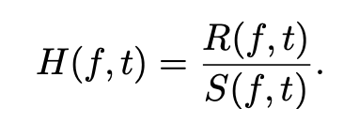
CRS as a side channel
In LTE systems, the User Equipments (UEs), e.g., mobile phones, use the CRS to estimate the Channel Frequency Response (CFR) of the downlink channel
Suppose that the BS transmits S(f, t) on a given subcarrier f at a given time t
In case that the received signal at the UE is R(f, t), the CFR can be calculated by:

Slide 12
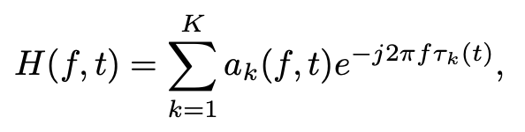
CRS as a side channel
Suppose a radio signal arrives at the receiving antenna through K different paths, then the CFR can be given as:
a_{k}(f, t) represents the attenuation and initial phase offset of the k^{th} path
e^{−j2πf τk(t)} is the phase shift on the k^{th} path
τ_{k}(t) is the path delay
With this model, the nearby human movements can be reflected in CFR measurement fluctuations based a similar model as in Wi-Fi systems

Slide 13
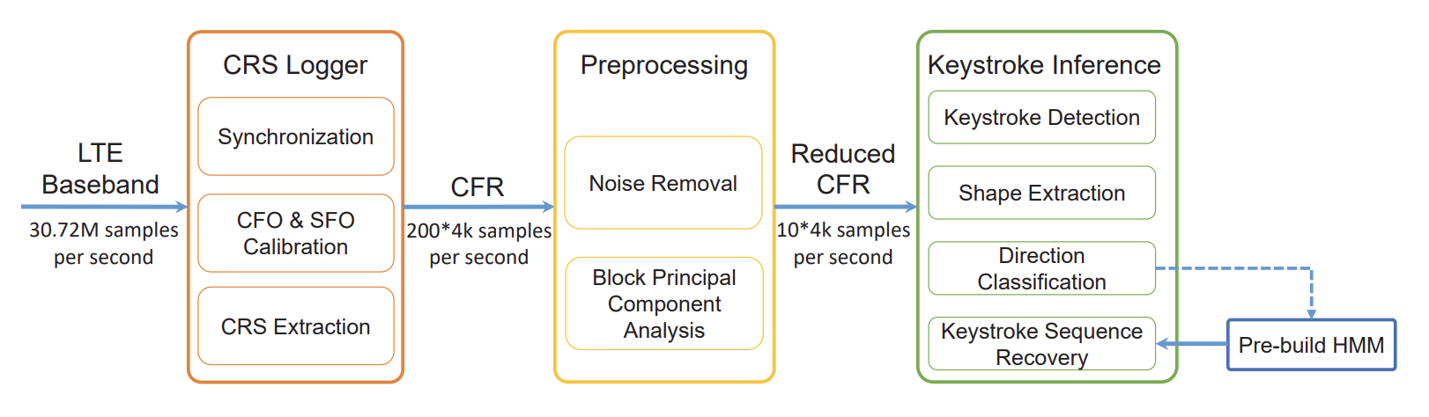
System Design

Slide 14
System Design
CRS Logger
Synchronization
find the carrier frequency of a nearby LTE BS and tune the USRP to its carrier frequency
CFO/SFO Calibration
As the transmitting BS and the receiver run at different clocks, there are both Carrier Frequency Offset (CFO) and Sampling Frequency Offset (SFO) in the received baseband signal. If not calibrated, they may accumulate and the system will lose synchronization after several minutes of continuous monitoring
CRS Extraction
Based on the PCI obtained from the synchronization step, it is possible to calculate in which subcarriers the CRS are transmitted as well as the value of the CRS

Slide 15
Data Preprocessing
Noise Removal
Reduce the impact of multi-path interference by directional antennas which amplify signals in the beam direction and reject signals in other directions
Use a moving-average filter to remove the high-frequency noises
Block Principal Component Analysis
Most of the CFR samples are redundant, so they introduce unnecessary computational costs in the keystroke recognition stage. Use PCA (Principal Component Analysis) to extract most principal components from raw CFR signals.
Block PCA: divide 200 subcarriers into 10 blocks, then each block performs PCA and takes the first principal component. Thus, the block PCA algorithm outputs ten principal components

Slide 16
Keystroke monitoring
Keystroke detection
use a moving variance algorithm to detect each keystroke event
calculate the variance from the block PCA results. Once the variance exceeds an empirically determined threshold, the system detects a keystroke event
Sometimes one keystroke movement may introduce multiple separated variation peaks, treat these movements as one keystroke if their time interval is less than 0.1 second

Slide 17
Keystroke recognition
Existing works treat each keystroke separately by assuming that the user always returns to a given posture after each keystrokes. In case of continuous typing, it was observed that the CFR measurements indicate the hand/finger movements between keys, instead of the key press
Model the process as a Hidden Markov Model (HMM) to infer the transition between subsequent keystrokes

Slide 18
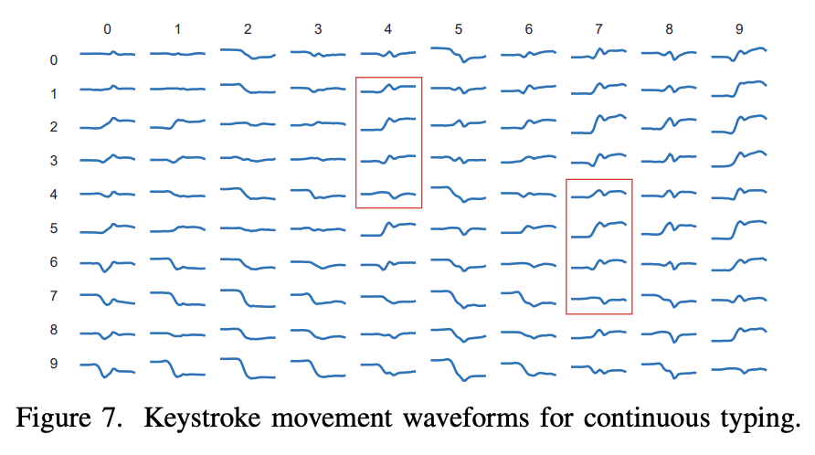
Keystroke Recognition
Shape extraction
extract the waveform shapes at keystroke events to determine the movements between keys
Perform wavelet decomposition on each PCA component and use the level-8 approximation coefficients as the output feature. For keystroke movement with a duration of two seconds, get a vector of length 28 for each PCA component

Slide 19
Keystroke recognition
Movement Direction Classification
use SVM-based classifier to determine the keystroke movements
Therefore, use a decoupled classifier to determine the movement distance and direction. Train two classifiers, one for the “x” (horizontal) direction and the other for the “y” (vertical) direction
the two SVM classifier are 5-category and 7-category respectively

Slide 20
Keystroke recognition
Building Hidden Markov Model
Model the keystroke process with a HMM indicated as λ = (N, M, A, B,π).
N is the number of hidden states; as there are 100 possible key pairs, so N = 100
M is the number of possible observations for hidden states; the results of the two classifier that gives five possible horizontal movements and seven possible vertical movements, so M = 5 × 7 = 35
The observation probability matrix B gives the possibility that a given observation can be observed in a hidden state; B is a N × M matrix where B_{jk} = P(observation k|state s_{j} )
The transition probability matrix A is the possibility a hidden state is transmitted to another hidden state; A is a N × N matrix with A_{ij} = P(state s_{j} at time t + 1|state s_{i} at time t)
The initial state distribution vector π indicates the possibility at the start of the key sequence

Slide 21
Building Hidden Markov Model
To build the HMM, need to determine the parameters A, B and π
The transmission probabilities between hidden states given in the matrix A can be predefined by the natural continuity of the typing process
use a uniform distribution for the initial state distribution π
The observation probability matrix B is determined through the training samples. first collect typing waveform shapes for different key pairs. Then use the two movement SVM classifier to calculate the probability that a given keystroke movement will emit certain observations

Slide 22
Keystroke recognition
Key Sequence Recovery
After building the Hidden Markov model, the key sequence recovery can be reduced to the following problem.
Given the observation sequence O = O₁O₂O₃ · · · O_{T} , find the optimal hidden sequence Q = q₁q₂q₃ · · · q_{T} , i.e., to maximize P(Q|O, λ)
This problem can be solved by the well-known Viterbi Algorithm that uses a dynamic programming approach

Slide 23
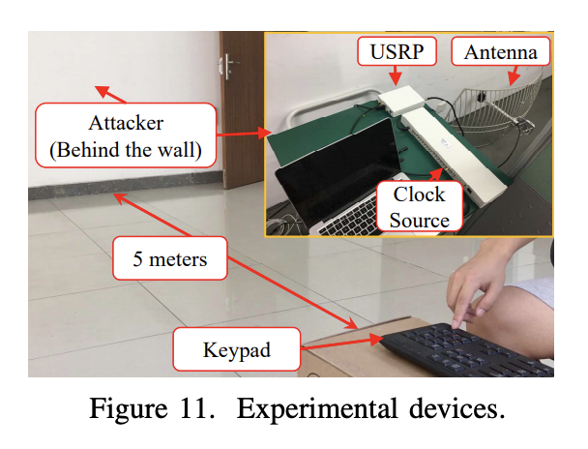
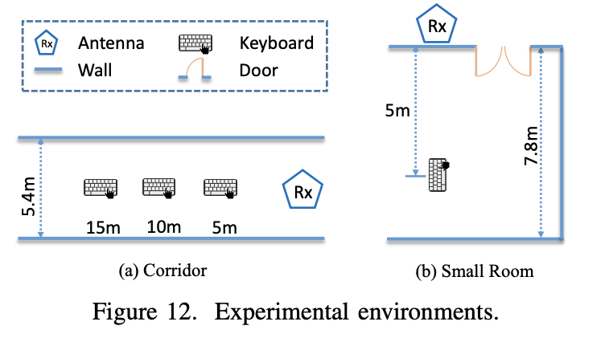
Implementation and Evaluation
Implementation
built SpiderMon on USRP B210 software radios with an external clock source OctoClock CDA2990
The BS used in the experiments has a central frequency of 2330 MHz and a bandwidth of 20 MHz
Keystroke samples are collected in two environments as shown in Figure 12, including a corridor environment for evaluating the operational distance and keyboard orientations and a small room for evaluating the through-wall scenario

Slide 24
Implementation and Evaluation
Evaluation Setup
The volunteers are asked to type on the numeric pad of a standard keyboard (Dell Keyboard KB212- B) to simulate PIN inputs on ATM-machines and smart door locks.
perform experiments in two different input modes, one is fixed initial position, the volunteers need to return to an initial position after each key press, and the other was a natural continuous input of PIN numbers

Slide 25
Implementation and Evaluation
Performance under fixed initial position mode
Requested the volunteers to type each key 60 times at three different distances (5m, 10m, and 15m ; At distances of 5m, 10m, and 15m, the average keystroke detection rates are 97.7%, 92.5%, and 95.0%, respectively
In results, 51% of the missing keys are due to the key ‘3’ and the missing rates of other keys are much smaller
The false positive rate of detection is 2.38 times per hour.
The average recognition accuracy is 77%, and the recognition accuracy of the key ‘5’ is the lowest (57%). The possible reason could be that the key ‘5’ is located at the center of the numeric keypad so that it has the largest number of adjacent keys
observe that most of the errors come from adjacent keys.

Slide 26
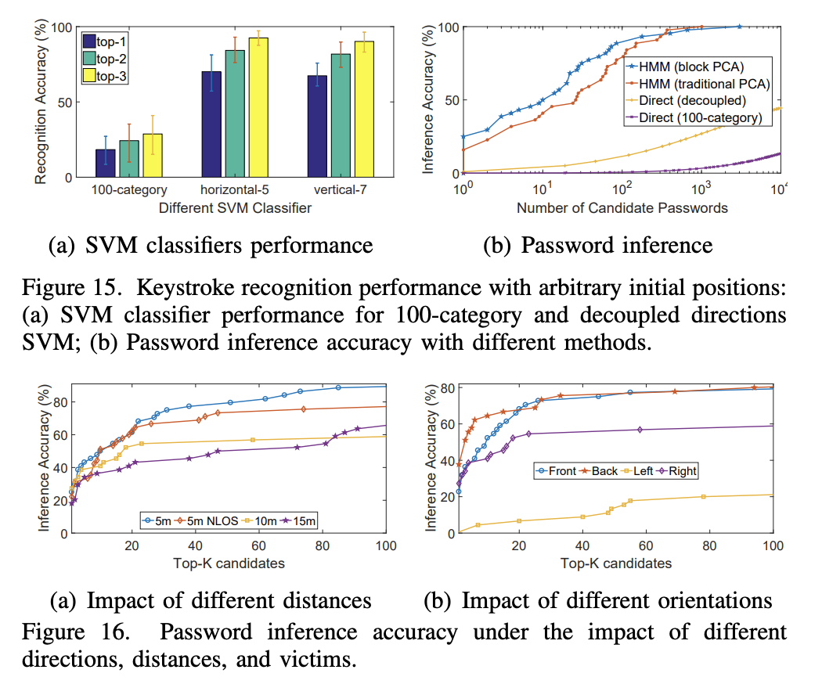
Implementation and Evaluation
Performance under continuous typing mode

Slide 27
Implementation and Evaluation
Impact of Distance and NLOS
evaluate the system performance when the victim was at different distances to the receiving antenna

Slide 28
Implementation and Evaluation
Impact of Keyboard Orientation
evaluate the performance of SpiderMon by placing the keyboard in four different directions (at a distance of 10 meters) so that the receiving antenna was pointed to the left, right, front, and back of the victim

Slide 29
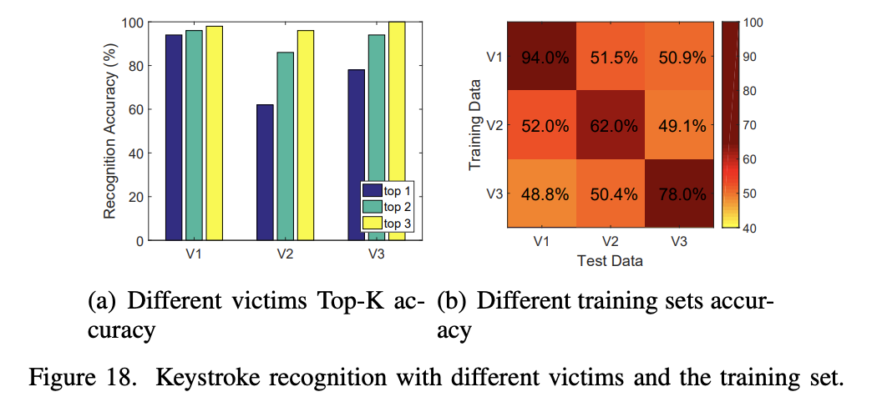
Implementation and Evaluation
Impact of Different Victims:
evaluate the impact of different typing styles with three volunteers as the victims

Slide 30
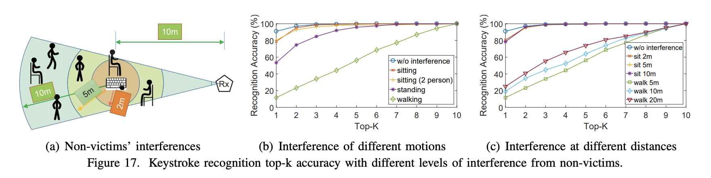
Implementation and Evaluation
Impact of Different Victims
evaluate the performance when other non-victims are in the target area, conducted two sets of single keystroke recognition experiments concerning the interference of different movement intensities and different interfere distances

Slide 31
Conclusion
LTE reference signals can be used as a medium for side-channel attacks by implementing the SpiderMon system that displays and analyzes LTE CRS signals in real-time
LTE-based attacks can achieve comparable performance while have a longer operational distance and do not need active transmissions, therefore are harder to be detected and lead to more serious security breaches

